Slide 1
Feature Engineering / Model Tuning & Deployment

Slide 2
Feature Engineering
For a model to become successful, the variables / parameters that are used to construct the model are critical. In their raw form, the variables may not be (usually are not) in a state where they can be used for modeling
Feature engineering is the process of transforming data from the raw state to a state where it becomes suitable for modeling.
It transforms the data columns into features that are better at representing a give situation in terms of clarity.
Quality of the feature in distinctly representing an entity impact the quality of the model in predicting the behavior of the entity
Exploratory Data Analytics (EDA) is the first step towards feature engineering as it is critical to assess the quality of the raw data, plan the transformations required

Slide 3
Exploratory data analytics (EDA)
Some of the key activities performed in EDA include –
Meaningful standardized names to the attributes
Meta information about the data. Describe the column level details such as what it is, how it was collected, units of measurement, frequency of measurement, possible range of values etc.
List and address the challenges that one will face using the data in its existing form. For e.g. missing values, outliers, data shift, sampling bias
Descriptive stats – spread(central values , skew, tails), mixup of gaussians
Data distribution across different target classes (if in classification domain)
Outlier analysis and strategy for imputations
Assessing the impact of the actions taken on the data (modified the distribution?

Slide 4
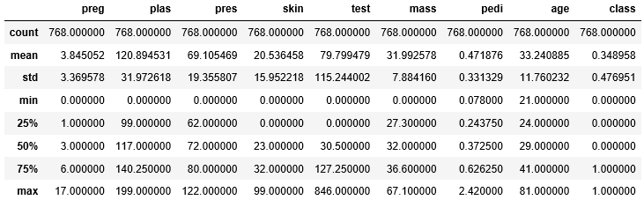
Ref: PIMA_Feature%20Engineering.ipynb
Missing Values
pima.describe()
Mean and Median differ but not too badly. Except in
‘test’, ‘pedi’
https://scikit-learn.org/stable/auto_examples/plot_missing_values.html#sphx-glr-auto-examples-plot-missing-values-py
Relatively long tail on higher side of the central values
Few extreme outliers except in ‘test’, ‘pedi’ which seems to have many outliers

Slide 5
Exploratory data analytics (EDA)
Imputing missing values using MICE function of statsmodel
The MICE module in statsmodel package allows models to be fit to a dataset with missing values on the independent and/or dependent variables
It treats each variable with missing values as the dependent variable in a regression, with some or all of the remaining variables as its predictors.
It cycles through these models, fitting each in turn, predicting the missing values. Since multiple models are used to predict the same missing value, the predicted values are likely to be different
It uses a procedure called “predictive mean matching” (PMM) to generate random draws from the predicted value distributions and uses the mean as predicted value
https://www.rdocumentation.org/packages/mice/versions/3.3.0/topics/mice

Slide 7
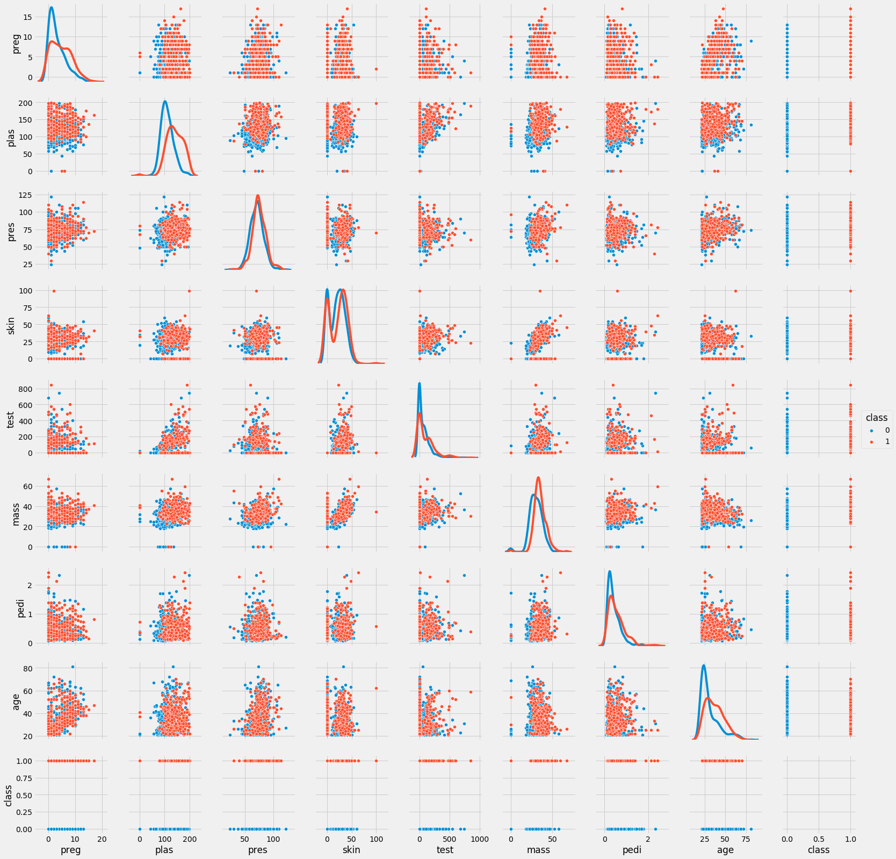
Long tails are seen on ‘test’, ‘pedi’ columns
On all the columns the distribution of the two classes are completely eclipsing one another
With minor differences in the distribution in ‘age’, ‘plas’
None of the columns can be good differentiators

Slide 8
Exploratory data analytics (EDA)
Some of the key activities performed in EDA include –
Transform the raw data into useful attributes by generating derived attributes from existing attributes if the derived attributes are likely to be better than original attributes in information content
Transform the data attributes using valid mathematical transformations such as log transformation of the distribution, if the transformed data is likely to help create simpler model without loosing information

Slide 9
Lab – 1
Load the data_banknote_authentication.txt file**
Analyze the data column wise
Handle missing values if any
Detect and handle outliers if any
Compare the distributions with the Pima Diabetes distribution. Why does this data set give such high degree of accuracy while Pima data set does not
Could we have done better in handling the outliers instead of replacing the outliers with central values. (how about class wise outlier analysis and replacing with 2standard dev?
** Owner of database: Volker Lohweg (University of Applied Sciences, Ostwestfalen-Lippe, volker.lohweg '@' hs-owl.de) , Donor of database: Helene DÃ¶rksen (University of Applied Sciences, Ostwestfalen-Lippe, helene.doerksen '@' hs-owl.de) Date received: August, 2012

Slide 10
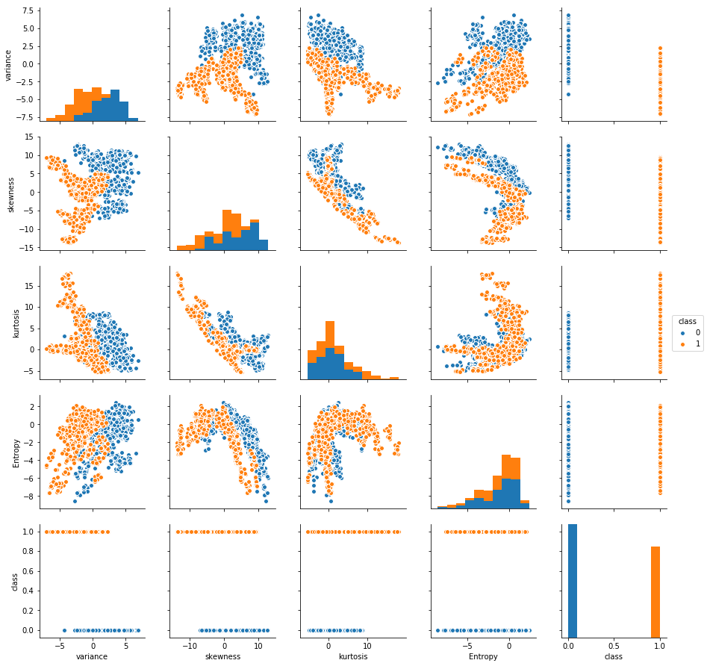
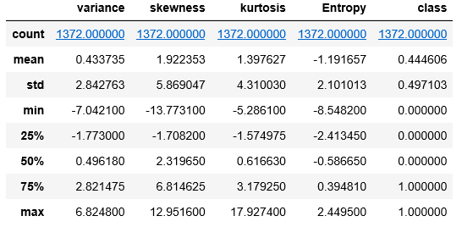
Lab – 1
data_banknote_authentication.txt
Do you think replacing outliers with central values was a good strategy? Could we have done something different
What changes do you notice in the pair plot on the different dimensions after the outlier handling
Do you think the score will be higher than the model on original data?
Look at the scales of the pairplot before and after we converted to Z score, do you think there was a need to do that?
Both in Pima dataset and this dataset, the classes are overlapping on every dimension. But models on this data give much better results. Why?
Ref:SVC_Bank_Note_Kernels.ipynb

Slide 11
Preprocessing attribute data
One of the most common transformations done on numeric data is the scale / measurement units of the data. The learning processes (gradient descent for e.g.) under the hood of various algorithms benefit from this
Rescale - Zscores – When the attributes have different scales, transform them into single scale. For this we can use MinMaxScaler or Zscores. Zscores helps also in centering the data i.e. the mean values of all numerical attributes become 0. Helpful in algorithms based on distance calculations, gradient descent based algorithms
Standardizing data – Transform the data on various attributes having a gaussian distributions with different standard deviations and means into distributions with mean =0 and standard deviation of 1. Useful for algorithms that expect gaussian distribution
Ref: https://scikit-learn.org/stable/modules/classes.html#module-sklearn.preprocessing

Slide 12
Preprocessing attribute data
Normalize data – Rescale all the attribute values such that each observation as a vector length of 1. Used when attributes have different scales and data is sparse. Can be useful for algorithms using distance calculations, learning process such as gradient descent
Binarize data - A way to convert a given attribute / target variable to 0,1. For e.g. it can be used to modify thresholds in probability based models such as logistic regression to improve class level predictions
Ref: https://scikit-learn.org/stable/modules/classes.html#module-sklearn.preprocessing

Slide 13
Outlier Analysis
What is an outlier? Some definitions:
It is an observation that :
deviates so much from other observations as to arouse suspicion that it was generated by a different mechanism
appears to deviate markedly from other members of the sample in which it occurs
appears to be inconsistent with the remainder of that set of data
Outlier detection methods:
Can be broadly divided into two categories:
Univariate methods – identify outliers on a single attribute using statistical analysis such as IQR (Inter Quartile Range) or standard deviation
Multivariate methods – identify outliers based on the trends in the data, use non statistical methods such as Mahalanobis distance

Slide 14
Outlier detection methods:
Can be broadly divided into two categories based on number of attributes :
Univariate methods – identify outliers on a single attribute using statistical analysis such as IQR (Inter Quartile Range) or standard deviation
Multivariate methods – identify outliers based on the trends in the data, use methods such as Mahalanobis distance
Can also be categorized based on type of methods used:
Parametric – Outliers is a function of the underlying distribution characteristics of the data e.g. assuming gaussian distribution and probability distribution. E.g Mu +- 3 std, Grubbs test, Chi square test etc.
Non-Parametric – Not based on the distribution characteristics. Eg. Histogram and KDE

Slide 15
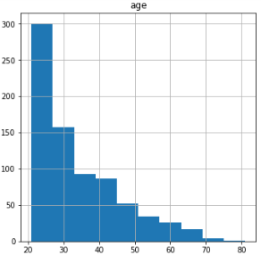
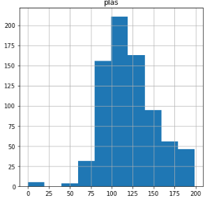
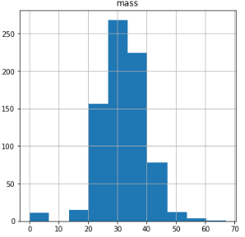
Histogram and Box plot for univariate outlier detection:

Slide 16
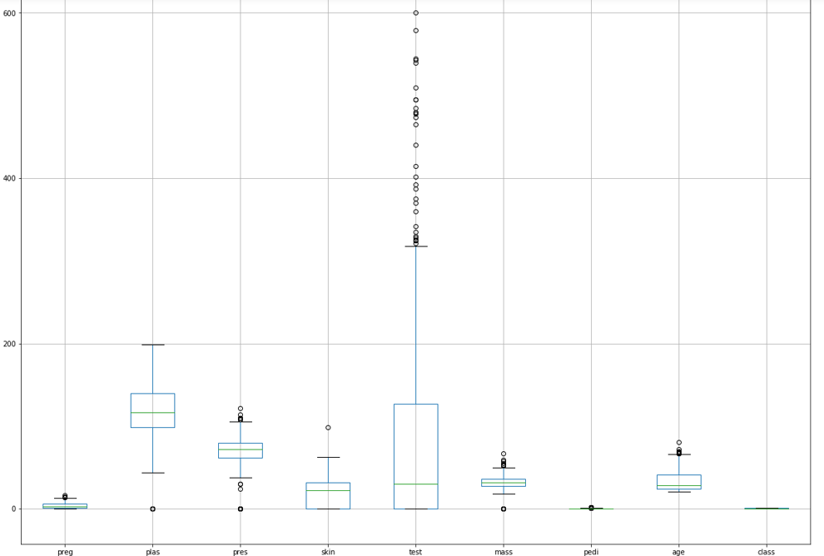
Histogram and Box plot for univariate outlier detection:

Slide 17
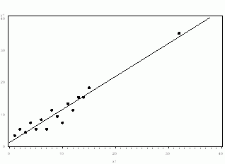
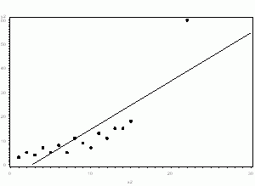
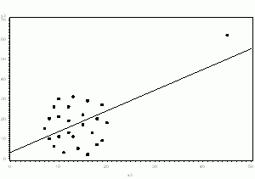
What is an outlier? It is an observation that
deviates so much from other observations as to arouse suspicion that it was generated by a different mechanism, appears to deviate markedly from other members of the sample in which it occurs, appears to be inconsistent with the remainder of that set of data
Some examples of outliers –

Slide 18
Masking and Swamping
Masking effect - one outlier masks a second outlier, if the second outlier can be considered as an outlier only by itself, but not in the presence of the first outlier. Thus, after the deletion of the first outlier the second instance is emerged as an outlier
Masking occurs when a cluster of outlying observations skews the mean and the covariance estimates toward it, and the resulting distance of the outlying point from the mean is small.
Swamping effect - one outlier swamps a second observation, if the latter can be considered as an outlier only under the presence of the first one. In other words, after the deletion of the first outlier the second observation becomes a non-outlying observation
Swamping occurs when a group of outlying instances skews the mean and the covariance estimates toward it and away from other non-outlying instances, and the resulting distance from these instances to the mean is large, making them look like outliers

Slide 19
Feature Engineering on Numeric data
Integers and floats are the most common data types that are directly used in building models. Instead, transforming them before modelling may yield better results!
Feature engineering on numerical columns may take the form of-
scaling the data if using algorithms that involve similarity measurements based on distance calculations
Transforming the distributions using mathematical techniques such as exponential distribution to almost normal using log functions
Binning the numeric data followed by binarization for e.g. using one-hot coding
Binning can help make linear models powerful when the data distribution on predictors is spread out though it has a trend
Interaction & Polynomial features – Another way to enrich feature representation, especially in linear models is using interaction features , polynomial features
In the binning example the linear model creates constant value in each bin (intercept), however, we can also make it learn the slope by including the original feature
Ref: Feature_Transform.ipynb

Slide 20
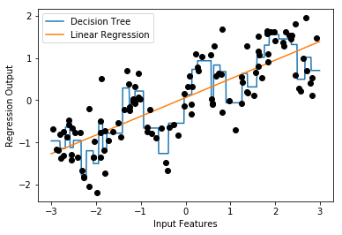
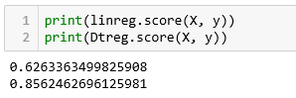
Feature Engineering on Numeric data
Linea Model and Binning, OneHotCoding
A comparison of decision tree and a simple linear model on the given data
Decision tree is more flexible and does better than linear model
Suppose we have to build linear model only, we can use binning to enrich the attributes
Note: This example uses a package mglearn which is available on Git (https://github.com/amueller/mglearn) and is used with a book “Introduction to Machine Learning with Python”

Slide 21
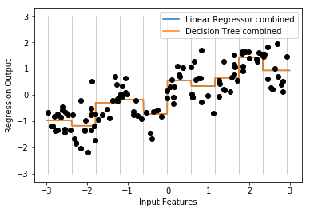
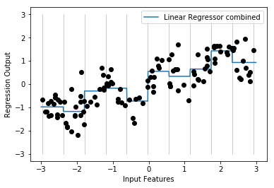
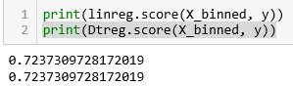
Feature Engineering on Numeric data
Linear Model and Binning, OneHotCoding
After binning, the decision tree boundaries and linear regression boundaries are exactly same. They are overlapping.
For each bin, both models are predicting a single value as output
Comparing the linear models before binning and after binning, we can see that the linear model has become more flexible.
Note: This example uses a package mglearn which is available on Git (https://github.com/amueller/mglearn) and is used with a book “Introduction to Machine Learning with Python”

Slide 22
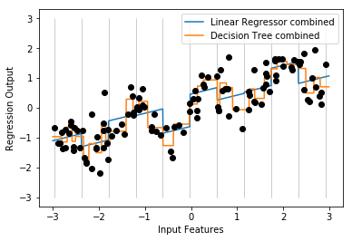
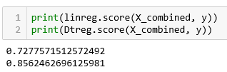
Feature Engineering on Numeric data
Linear Model with binning and original value combined
The input data is not only the bins but also include the original X column
Presence of the original column with each bin, introduces a slope and offset for each bin. For e.g. [-0.75275929, 0. , 0. , 0. , 1. , 0. , 0. , 0. , 0. , 0. , 0. ]
Linear model performance as marginally gone up
Decision tree, given it’s non-parametric property, has become more complex and hence accurate
Note: This example uses a package mglearn which is available on Git (https://github.com/amueller/mglearn) and is used with a book “Introduction to Machine Learning with Python”

Slide 23
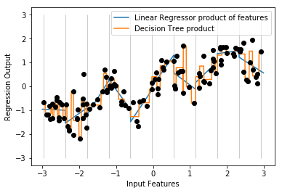
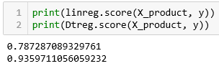
Feature Engineering on Numeric data
Linear Model with binning and interaction features
Create an interaction feature by using simple multiple operation. For e.g. X_product = np.hstack([X_binned, X_binned * X])
The input data now has onehotcoded bins with one bin carrying the original value for e.g. [ 0. , 0. , 0. , 1. , 0. , 0. , 0. , 0. , 0. , 0. , -0. , -0. , -0. , -0.75275929, -0. , -0. , -0. , -0. , -0. , -0. ]
Note: This example uses a package mglearn which is available on Git (https://github.com/amueller/mglearn) and is used with a book “Introduction to Machine Learning with Python”

Slide 24
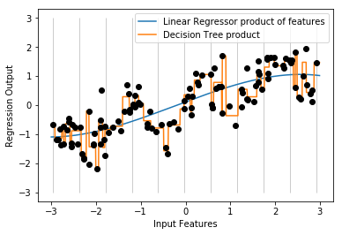
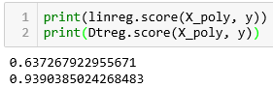
Feature Engineering on Numeric data
Linear Model with binning and polynomial features
Create polynomial features from the original column using the function poly = PolynomialFeatures(degree=3, include_bias=False)
In this example degree is 3 which means we will have x, x^2, x^3 as our features
As expected, decision tree overfits while the linear model seems underfit at this degree
Note: This example uses a package mglearn which is available on Git (https://github.com/amueller/mglearn) and is used with a book “Introduction to Machine Learning with Python”

Slide 25
Feature Engineering on Numeric data
Linear Model with binning and polynomial features
Create polynomial features from the original column using the function poly = PolynomialFeatures(degree=3, include_bias=False)
In this example degree is 3 which means we will have x, x^2, x^3 as our features
As expected, decision tree overfits while the linear model seems underfit at this degree
Note: This example uses a package mglearn which is available on Git (https://github.com/amueller/mglearn) and is used with a book “Introduction to Machine Learning with Python”

Slide 26
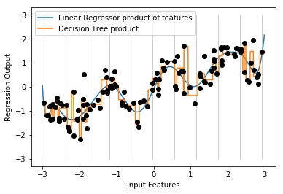
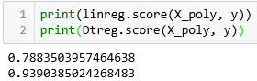
Feature Engineering on Numeric data
Linear Model with binning and polynomial features
Create polynomial features from the original column using the function poly = PolynomialFeatures(degree=15, include_bias=False)
The linear regression line is now looking a better fit
Polynomial features have a problem with extreme values or in regions where data is scant.
SVM /SVR may be a natural choice as SVR generates features using kernels automatically
Note: This example uses a package mglearn which is available on Git (https://github.com/amueller/mglearn) and is used with a book “Introduction to Machine Learning with Python”

Slide 27
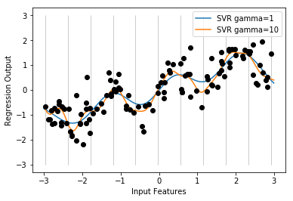
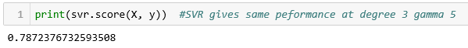
Feature Engineering on Numeric data
Linear Model with SVM/SVR Kernel Tricks
SVM generates polynomial features based on the degree mentioned. Default degree = 3
The gamma factor controls the flexibility of the curve
Since SVM uses kernel tricks, it does not generate all the synthetic features. However, it gets the benefits of the same
Kernel trick saves computation time and resources which may prove too costly when working with polynomial features
Note: This example uses a package mglearn which is available on Git (https://github.com/amueller/mglearn) and is used with a book “Introduction to Machine Learning with Python”

Slide 28
Regularization for Feature Selection
Linear Model with binning and polynomial features
SVM generates polynomial features based on the degree mentioned. Default degree = 3
The gamma factor controls the flexibility of the curve
Since SVM uses kernel tricks, it does not generate all the synthetic features. However, it gets the benefits of the same
Kernel trick saves computation time and resources which may prove too costly when working with polynomial features

Slide 29
Linear Regression Model -
Lab- 1- Estimating mileage based on features of a second hand car
Description – Sample data is available at https://archive.ics.uci.edu/ml/datasets/Auto+MPG
The dataset has 9 attributes listed below that define the quality
1. mpg: continuous 2. cylinders: multi-valued discrete 3. displacement: continuous 4. horsepower: continuous 5. weight: continuous 6. acceleration: continuous 7. model year: multi-valued discrete 8. origin: multi-valued discrete 9. car name: string (unique for each instance)
Sol : Ridge_Lasso_Regression.ipynb

Slide 30
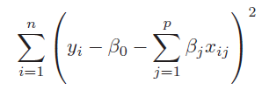
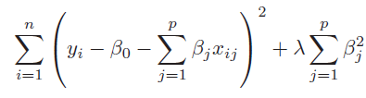
Regularising Linear Models (Shrinkage methods)
When we have too many parameters and exposed to curse of dimensionality, we resort to dimensionality reduction techniques such as transforming to PCA and eliminating the PCA with least magnitude of eigen values. This can be a laborious process before we find the right number principal components. Instead, we can employ the shrinkage methods.
Shrinkage methods attempt to shrink the coefficients of the attributes and lead us towards simpler yet effective models. The two shrinkage methods are :
Ridge regression is similar to the linear regression where the objective is to find the best fit surface. The difference is in the way the best coefficients are found. Unlike linear regression where the optimization function is SSE, here it is slightly different
The term is like a penalty term used to penalize large magnitude coefficients when it is set to a high number, coefficients are suppressed significantly. When it is set to 0, the cost function becomes same as linear regression cost function
Linear Regression cost function
Ridge Regression with additional term in the cost function

Slide 31
Regularising Linear Models (Shrinkage methods)
Why should we be interested in shrinking the coefficients? How does it help?
When we have large number of dimensions and few data points, the models are likely to become complex, overfit and prone to variance errors. When you print out the coefficients of the attributes of such complex model, you will notice that the magnitude of the different coefficients become large
Large coefficients indicate a case where for a unit change in the input variable, the magnitude of change in the target column is very large.
Coeff for simple linear regression model of 10 dimensions
Coeff with polynomial features shooting up to 57 from 10
-9.67853872e-13 -1.06672046e+12 -4.45865268e+00 -2.24519565e+00 -2.96922206e+00 -1.56882955e+00 3.00019063e+00 -1.42031640e+12 -5.46189566e+11 3.62350196e+12 -2.88818173e+12 -1.16772461e+00 -1.43814087e+00 -7.49492645e-03 2.59439087e+00 -1.92409515e+00 -3.41759793e+12 -6.27534905e+12 -2.44065576e+12 -2.32961194e+12 3.97766113e-01 1.94046021e-01 -4.26086426e-01 3.58203125e+00 -2.05296326e+00 -7.51019934e+11 -6.18967069e+11 -5.90805593e+11 2.47863770e-01 -6.68518066e-01 -1.92150879e+00 -7.37030029e-01 -1.01183732e+11 -8.33924574e+10 -7.95983063e+10 -1.70394897e-01 5.25512695e-01 -3.33097839e+00 1.56301740e+12 1.28818991e+12 1.22958044e+12 5.80200195e-01 1.55352783e+00 3.64527008e+11 3.00431724e+11 2.86762821e+11 3.97644043e-01 8.58604718e+10 7.07635073e+10 6.75439422e+10 -7.25449332e+11 1.00689540e+12 9.61084146e+11 2.18532428e+11 -4.81675252e+12 2.63818648e+12
The coefficient for cyl is 2.5059518049385052
The coefficient for disp is 2.5357082860560483
The coefficient for hp is -1.7889335736325294
The coefficient for wt is -5.551819873098725
The coefficient for acc is 0.11485734803440854
The coefficient for yr is 2.931846548211609
The coefficient for car_type is 2.977869737601944
The coefficient for origin_america is -0.5832955290166003
The coefficient for origin_asia is 0.3474931380432235
The coefficient for origin_europe is 0.3774164680868855
Ref: Ridge_Lasso_Regression.ipynb
Very large coefficients!

Slide 32
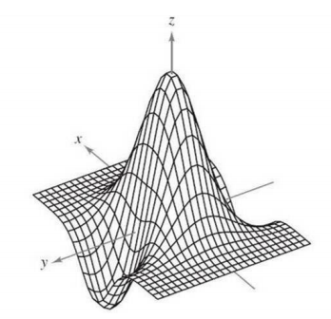
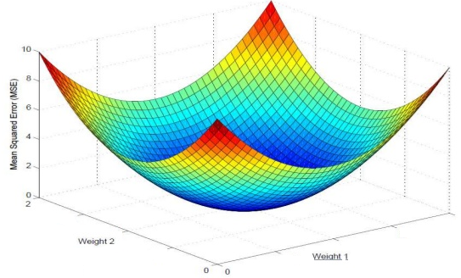
Regularising Linear Models (Shrinkage methods)
Z = f ( x, y)
Curse of dimensionality results in large magnitude coefficients which results in a complex undulated surface / model.
This complex surface has the data points occupying the peaks and the valleys
The model gives near 100% accuracy in training but poor result in testing and the testing scores also vary a lot from one sample to another.
The model is supposed to have absorbed the noise in the data distribution!
Large magnitudes of the coefficient give the least SSE and at times SSE = 0! A model that fits the training set 100%!
Such models do not generalize
= 0

Slide 33
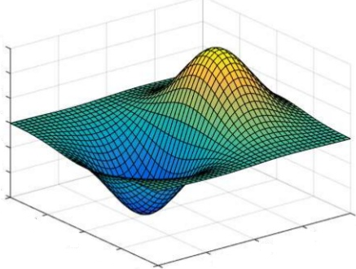
Regularising Linear Models (Shrinkage methods)
In Ridge Regression, the algorithm while trying to find the best combination of coefficients which minimize the SSE on the training data, is constrained by the penalty term
The penalty term is akin to cost of magnitude of the coefficients. Higher the magnitude, more the cost. Thus to minimize the cost, the coefficient are suppressed
Thus the resulting surface tends to be relatively much more smoother than the unconstrained surface. This means we have settled for a model which will make errors in the training data
This is fine as long as the errors can be attributed to the random fluctuations i.e. because the model does not absorb the random fluctuations in the data
Such model will perform equally well on unseen data i.e. test data. The model will generalize better than the complex model
Z = f ( x, y)

Slide 34
Regularising Linear Models (Shrinkage methods)
Impact of Ridge Regression on the coefficients of the 56 attributes
Ridge model: [[ 0. 3.73512981 -2.93500874 -2.13974194 -3.56547812 -1.28898893 3.01290805
2.04739082 0.0786974 0.21972225 -0.3302341 -1.46231096 -1.17221896 0.00856067 2.48054694
-1.67596093 0.99537516 -2.29024279 4.7699338 -2.08598898 0.34009408 0.35024058 -0.41761834
3.06970569 -2.21649433 1.86339518 -2.62934278 0.38596397 0.12088534 -0.53440382 -1.88265835
-0.7675926 -0.90146842 0.52416091 0.59678246 -0.26349448 0.5827378 -3.02842915 -0.36548074
0.5956112 -0.15941014 0.49168856 1.45652375 -0.43819158 -0.20964198 0.77665496 0.36489921
-0.4750838 0.3551047 0.23188557 -1.42941282 2.06831543 -0.34986402 -0.32320394 0.39054656 0.06283411]]
Large coefficients have been suppressed, almost close to 0 in many cases.
Ref: Ridge_Lasso_Regression.ipynb

Slide 35
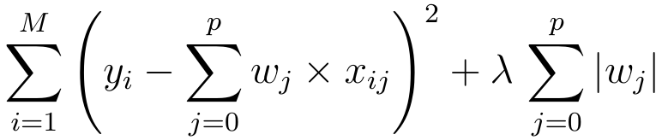
Regularising Linear Models (Shrinkage methods)
Lasso Regression is similar to the Ridge regression with a difference in the penalty term. Unlike Ridge, the penalty term here is raised to power 1. Also known as L1 norm.
The term continues to be the input parameter which will decide how high penalties would be for the coefficients. Larger the value more diminished the coefficients will be.
Unlike Ridge regression, where the coefficients are driven towards zero but may not become zero, Lasso Regression penalty process will make many of the coefficients 0. In other words, literally drop the dimensions

Slide 36
Regularising Linear Models (Shrinkage methods)
Impact of Lasso Regression on the coefficients of the 56 attributes
Lasso model: [ 0. 0.52263805 -0.5402102 -1.99423315 -4.55360385 -0.85285179 2.99044036 0.00711821 -0. 0.76073274 -0. -0. -0.19736449
0. 2.04221833 -1.00014513 0. -0. 4.28412669 -0. 0. 0.31442062 -0. 2.13894094 -1.06760107 0. -0. 0. 0. -0.44991392 -1.55885506 -0. -0.68837902 0.
0.17455864 -0.34653644 0.3313704 -2.84931966 0. -0.34340563 0.00815105 0.47019445 1.25759712 -0.69634581 0. 0.55528147 0.2948979 -0.67289549
0.06490671 0. -1.19639935 1.06711702 0. -0.88034391 0. -0. ]
Large coefficients have been suppressed, to 0 in many cases, making those dimensions useless i.e. dropped from the model.
Ref: Ridge_Lasso_Regression.ipynb

Slide 37
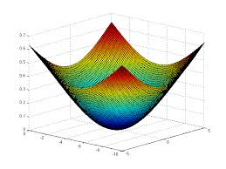
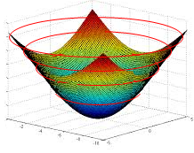

Regularising Linear Models (Comparing The Methods)
To compare the Ridge and Lasso, let us first transform our error function (which is a quadratic / convex function) into a contour graph
Every ring on the error function represents a combination of coefficients (m1 and m2 in the image) which result in same quantum of error i.e. SSE
Let us convert that to a 2d contour plot. In the contour plot, every ring represents one quantum of error.
The innermost ring / bull’s eye is the combination of the coefficients that gives the lease SSE
m2
m1

Slide 38
Regularising Linear Models (Ridge Constraint)
Most optimal combination of m1, m2 given the constraints
Yellow circle is the Ridge constraint region representing the ridge penalty (sum of squared coeff)
Any combination of m1 nd m2 that fall within yellow is a possible solution
The most optimal of all solutions is the one which satisfies the constraint and also minimizes the SSE (smallest possible red circle)
Thus the optimal solution of m1 and m2 is the one where the yellow circle touches a red circle.
Lowest SSE error ring. violates the constraint
m2
Sub-optimal combination of m1, m2. Meets constraint but is not the minimal possible SSE within constraint
Allowed combination of m1, m2 by Ridge Constraints
m1
The point to note is that the red rings and yellow circle will never be tangential (touch) on the axes representing the coefficient. Hence Ridge can make coefficients close to zero but never zero. You may notice some coefficients becoming zero but that will be due to roundoff…

Slide 39
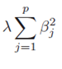

Regularising Linear Models (Ridge Constraint)
As the lambda value (shown here as alpha) increases, the coefficients have to become smaller and smaller to minimize the penalty term in the cost function i.e. the
The larger the lambda, smaller the sum of squared coefficients should be and as a result the tighter the constraint region
The tighter the constraint region, the larger will be the red circle in the contour diagram that will be tangent to the boundary of the yellow region
Thus, higher the lambda, stronger the shrinkage, the coefficients are shrinked strongly and hence more smooth the surface / model
More smoother the surface, more likely the model is going to perform equally well in production
When we move away from a model with sharp peaks and valleys (complex model) to smoother surface (simpler models), we reduce the variance errors but bias errors go up.
Using gridsearch, we have to find the right value of lambda which results in right fit, neither too complex nor too simple a model
m2
m1

Slide 40
Regularising Linear Models (Lasso Constraint)
Most optimal combination of m1, m2 given the constraints
Yellow rectangle is the Lasso constraint region representing the Lasso penalty (sum coeff)
Any combination of m1 nd m2 that fall within yellow is a possible solution
The most optimal of all solutions is the one which satisfies the constraint and also minimizes the SSE (smallest possible red circle)
Thus the optimal solution of m1 and m2 is the one where the yellow rectangle touches a red circle.
Lowest SSE error ring. violates the constraint
m2
Sub-optimal combination of m1, m2. Meets constraint but is not the minimal possible SSE within constraint
Allowed combination of m1, m2 by Lasso Constraints
m1
The beauty of Lasso is, the red circle may touch the constraint region on the attribute axis! In the picture above the circle is touching the yellow rectangle on the m1 axis. But at that point m2 coefficient is 0! Which means, that dimension has been dropped from analysis. Thus Lasso does dimensionality reduction which Ridge does not

Slide 41
HyperParameter Tuning

Slide 42
Hyper Parameters & Tuning
Hyper parameters are like handles available to the modeler to control the behavior of the algorithm used for modeling
Hyper parameters are supplied as arguments to the model algorithms while initializing them. For e.g. setting the criterion for decision tree building “dt_model = DecisionTreeClassifier(criterion = 'entropy’ )”
To get a list of hyper parameters for a given algorithm, call the function get_params()…for e.g. to get support vector classfier hyper parameters
from sklearn.svm import SVC
svcl= SVC()
svc.get_params()
Hyper parameters are not learnt from the data as other model parameters are. For e.g. attribute coefficients in a linear model are learnt from data while cost of error is input as hyper parameter. Ref: model_parameters.csv
Ref: Models_HyperParameters.ipynb

Slide 43
Hyper Parameters & Tuning
Fine tuning the hyper parameters is done in a sequence of steps
Selecting the appropriate model type (regressor or classifier such as sklearn.svm.SVC())
Identify the corresponding parameter space (Ref: model_parameters.csv)
Decide the method for searching or sampling parameter space;
Decide the cross-validation scheme to ensure model will generalize
Decide a score function to use to evaluate the model
Two generic approaches to searching hyper parameter space include
GridSearchCV which exhaustively considers all parameter combinations
RandomizedSearchCV can sample a given number of candidates from a parameter space with a specified distribution.
While tuning hyper parameters, the data should have been split into three parts – Training, validation and testing to prevent data leak
The testing data should be separately transformed * using the same functions that were used to transform the rest of the data for model building and hyper parameter tuning
Ref: GridSearchSimpleExample.ipynb
* Any transformation where rows influence each other. For e.g. using zscore. OneHotCode transformation does not come into this category. It can be done before splitting the data

Slide 44
Hyper Parameters & Tuning (GridsearchCV/ RandomizedSearchCv)
GridsearchCV –
Is at basic optimal hyperparameter tuning technique.
It builds a model for each permutation of all of the given hyperparameter values
Each such model is evaluated and ranked.
The combination of hyperparameter values that gives the best performing model is chosen
For every combination, cross validation is used and average score is calculated
This is an exhaustive sampling of the hyperparameter space and can be quite inefficient

Slide 45
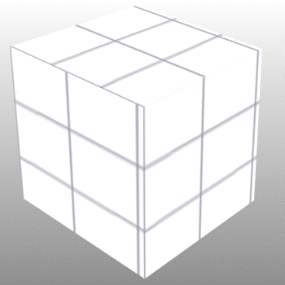
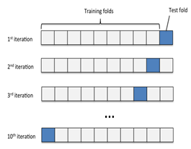
GridSearchCV
One combination of hyper parameters used K times to train and test. The avg score of the K times is the score associated with this combination
This will repeat for all possible combinations i.e. all the cells in the space.
hp3
hp2
hp1
Hyper parameter space
Ref: Simple_Gridsearch.ipynb ,
GridSearchCV_compare_models.ipynb,

Slide 46
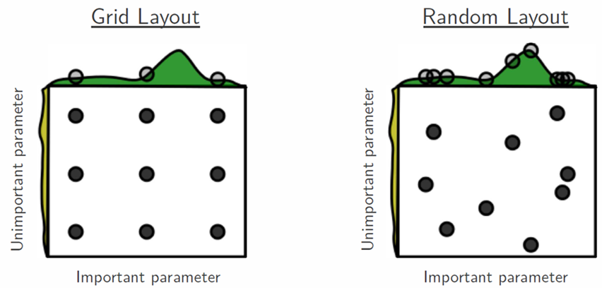
Hyper Parameters & Tuning (GridsearchCV/ RandomizedSearchCv)
RandomizedSearchCV –
Random search differs from grid search. Instead of providing a discrete set of values to explore on each hyperparameter (parameter grid), we provide a statistical distribution.
Values for the different hyper parameters are picked up at random from this combine distribution
The motivation to use random search in place of grid search is that for many cases, hyperparameters are not equally important.
A Gaussian process analysis of the function from hyper-parameters to validation set performance reveals that for most data sets only a few of the hyper-parameters really matter, but that different hyper-parameters are important on different data sets. This phenomenon makes grid search a poor choice for configuring
algorithms for new data sets. - Bergstra, 2012
Picture by Bergstra, 2012

Slide 47
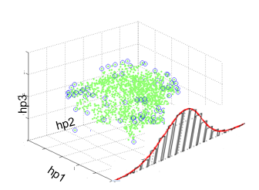
RandomizedSearchCV
Randomly pick up n-iter samples from the hyper parameter distribution as sample, Use it K times and find avg performance
Hyper parameter space
Ref: RandomizedSearchCV_GridSearchCV.ipynb
In contrast to GridSearchCV, not all combinations are evaluated. A fixed number of parameter settings is sampled from the specified distributions.
The number of parameter settings that are tried is given by n_iter
If all parameters are presented as a list, sampling without replacement is performed. If at least one parameter is given as a distribution, sampling with replacement is used. It is highly recommended to use continuous distributions for continuous parameters
Randomsearch has higher chance of hitting the right combination than gridsearch. Ref: Decision_Tree_Regressor_Concrete_Regularization_GridSearchCV.ipynb

Slide 48
Performance Evaluation

Slide 49
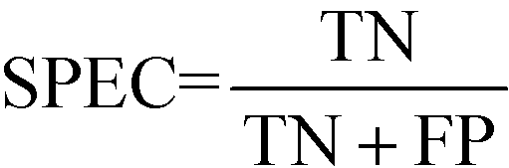
Model performance measures
Confusion Matrix – A 2X2 tabular structure reflecting the performance of the model in four blocks
Accuracy – How accurately / cleanly does the model classify the data points. Lesser the false predictions, more the accuracy
Sensitivity / Recall – How many of the actual True data points are identified as True data points by the model . Remember, False Negatives are those data points which should have been identified as True.
Specificity – How many of the actual Negative data points are identified as negative by the model
Precision – Among the points identified as Positive by the model, how many are really Positive
Confusion Matrix | Predicted Positive | Predicted Negative
Actual Positive | True Positive | False Negative
Actual Negative | False Positive | True Negative
Ref: http://localhost:8888/notebooks/FMTS/classification_metrics-1.ipynb
http://localhost:8888/notebooks/FMTS/ROC_AUC.ipynb

Slide 50
Model performance measures
Assume model is identifying defaulters. In this binary classification defaulter class is class of interest and labeled as +ive (positive - 1) class, other class is –ve(negative - 0)
True Positives - cases where the actual class of the data point and the predicted is same. For e.g. a defaulter (1) predicted as defaulter (1)
True Negatives – cases where the actual class was non-defaulter and the prediction also was non-defaulter
False Positives – cases where actual class was negative (0) but predicted as defaulter (1)
False Negatives – cases where the actual class was positive (1) but predicted as non-defaulter (0)
Ideal scenario will be when all positives are predicted as positives and all negatives are predicted as negatives

Slide 51
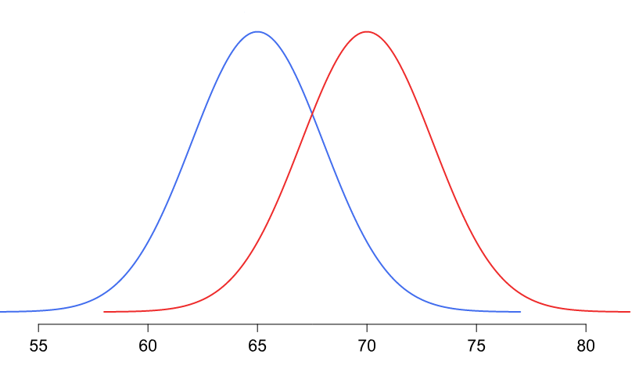
Model performance measures
In practical world this will never be the case. There will be some false positives and false negatives
Our objective will be to minimize both but the problem is, when we minimize one the other will increase and vice versa!
The problem is in the overlap region in the distributions
Objective will be to minimize one of the error types, either the false positive or false negative
Threshold
Non-default
Default
Problem region
Attribute x

Slide 52
Model performance measures
Minimize false negatives - if predicting a positive case as negative is going to be more detrimental for e.g. predicting a cancer patient (positive) as non-cancer (negative)
Minimize false positives – if predicting a negative as positive is going to be more detrimental for e.g. predicting a boss’s mail as spam!
Accuracy – over all correct predictions from all the classes to total number of cases. Should rely on this metrics only when all classes are equally represented. Not reliable if class representation is lopsided as algorithms are biased towards over represented class
Precision - TP/ TP+ FP. When we focus on minimizing false negatives, TP will increase but along with it FP will also increase. How much increase in TP starts hurting (due to increase in FP) ?

Slide 53
Model performance measures
Recall – TP / TP + FN : when we reduce FN to increase TP, how much we gain ? Recall and precision will oppose each other. We want recall to be as close to 1 as possible without precision being too bad
To compare models, we use ROC AUC that gives us the optimal combination of these metrics

Slide 54
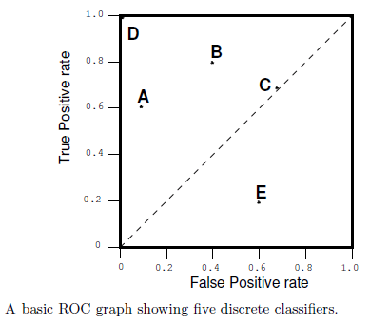
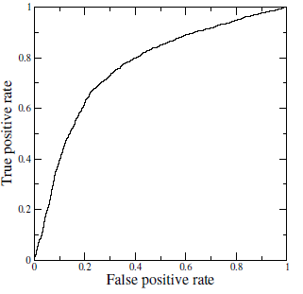
Receiver Operating Characteristics (ROC) Curve
A technique for visualizing classifier performance
It is a graph between TP rate and FP rates
TP rate = TP / total positive
FP rate = FP / total negative
ROC graph is a trade off between benefits (TP) and costs (FP)
The point (0,1) represents perfect classified (e.g. D)
TP = 1 and FP = 0
Classifiers very close to Y axis and lower (nearer to x axis) are conservative models and strict in classifying positives (low TP rate)
Classifiers on top right are liberal in classifying positives hence higher TP rate and FP rate
Ref:ROC_AUC.ipynb , ROC_Threshold_Management.ipynb

Slide 55
Pipelines

Slide 56
Pipelines
Sequentially apply a list of transforms and a final estimator.
Intermediate steps of the pipeline must be ‘transforms’, that is, they must implement fit and transform methods.
The final estimator only needs to implement fit
Helps standardize the model project by enforcing consistency in building testing and production. Ref: https://scikit-learn.org/stable/modules/compose.html
Building Model
Load Data
Split data
Scale data
Call functions
fit()
Predicting
Load Data
Split data
Scale data
Call functions
predict()
Ref:Pipeline_Simple.ipynb, Pipeline_Gridsearch.ipynb

Slide 57
Sampling

Slide 58
It all begins with sampling…. So do bias and variance errors
For a sample to be close representative of the population we need the right attributes, right size, correct class representation
A sample being subset of the population can fall short of these requirements. As a result, it represents subset of the patterns, also have unexplained patterns that get clubbed as residuals
Problem becomes acute when we are in classification and the data is imbalanced in terms of representing the classes.

Slide 59
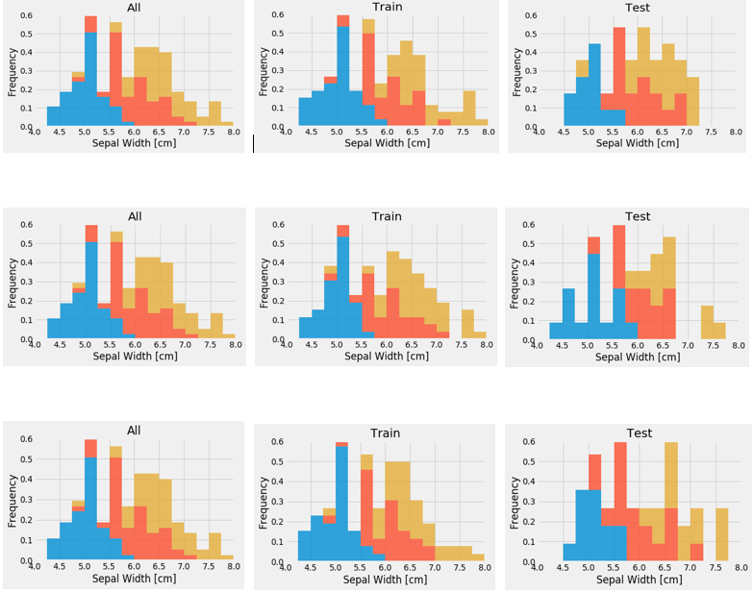
Sample Data (Analytics Base Table)
Three Random Training Sets From ABT
Three Random Test Sets From ABT

Slide 60
Imbalanced datasets impact outcome of ML models negatively when the class of importance is under represented
The ML algorithms such as decision trees, logistic regressions are designed to reduce overall inaccuracies and hence get biased towards over represented class
When class of importance is under represented, no amount of tuning the models will help
Suppose we have 1000 records of which 20 are fraudulent cases and 980 normal cases. We have to predict fraudulent cases accurately. The event rate is only 2%. Conventional classifiers tend to perform higher Type II errors (fraudulent cases identified as normal)

Slide 61

We can handle the imbalanced dataset cases to minimize the Type II errors by balancing the class representations
To balance the classes we can –
Decrease the frequency of the majority class
Increase the frequency of the minority class OR

Slide 62
Decreasing the frequency of majority class is done using random under sampling. For e.g.
Total observations – 1000
Fraud - 020
Non-fraud - 980
Event rate of interest - 2%
Take 10% of non-fraud cases randomly - 98
Club with the fraud cases – 118 sample size
Modified event rate - 20 / 118 = 17%
Ref: Logistic_up_down_sample_Pima.ipynb

Slide 63
Random oversampling is used to increase the frequency of minority class. This is done by replicating them in order to increase their representation. For e.g.
Total observations – 1000
Fraud - 020
Non-fraud - 980
Event rate of interest - 2%
Replicate a % of fraud cases n times e.g. 10 cases 20 times
Sample size changes from 1000 to 1200
Modified event rate - 220/1200 = 18%
The simplest implementation of over-sampling is to duplicate random records from the minority class, which can cause overfitting.
In under-sampling, the simplest technique involves removing random records from the majority class, which can cause loss of information.
Ref: Logistic_up_down_sample_Pima.ipynb

Slide 64
Imblearn Techniques
Python imbalanced-learn module – provides more sophisticated resampling techniques
For example, we can cluster the records of the majority class, and do the under-sampling by removing records from each cluster, thus seeking to preserve information.
In over-sampling, instead of creating exact copies of the minority class records, we can introduce small variations into those copies, creating more diverse synthetic samples.
Ref: Logistic_up_down_sample_Pima.ipynb

Slide 65
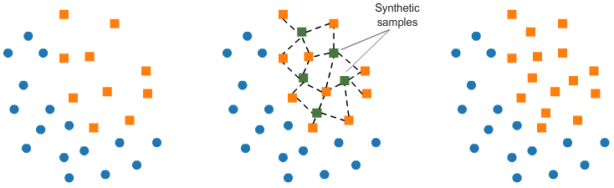
Imblearn Techniques
SMOTE (Synthetic Minority Oversampling TEchnique)
consists of synthesizing elements for the minority class, based on those that already exist.
It works randomly picking a point from the minority class and computing the k-nearest neighbors for this point.
Synthetic points are added between the chosen point and its neighbors.
Ref: Logistic_up_down_sample_Pima.ipynb

Slide 66

Imblearn Techniques
Tomek links T-Link
Tomek links are pairs of very close instances, but of opposite classes.
Removing the instances of the majority class of each pair increases the space between the two classes, facilitating the classification process.

Slide 67
Imblearn Techniques
Cluster centroid based under sampling -
Method that under samples the majority class by replacing a cluster of majority samples by the cluster centroid of a KMeans algorithm.
This algorithm keeps N majority samples by fitting the KMeans algorithm with N cluster to the majority class and using the coordinates of the N cluster centroids as the new majority samples.

Slide 68
The imbalanced-learn documentation: http://contrib.scikit-learn.org/imbalanced-learn/stable/index.html
The imbalanced-learn GitHub: https://github.com/scikit-learn-contrib/imbalanced-learn
Comparison of the combination of over- and under-sampling algorithms: http://contrib.scikit-learn.org/imbalanced-learn/stable/auto_examples/combine/plot_comparison_combine.html
Chawla, Nitesh V., et al. "SMOTE: synthetic minority over-sampling technique." Journal of artificial intelligence research 16 (2002): https://www.jair.org/media/953/live-953-2037-jair.pdf

Slide 69
Deploying Models

Slide 70
Serializing / Deserializing Python objects -
All models are objects. For e.g.
model = LogisticRegression(solver='lbfgs')
model.fit(train_set, train_labels)
In the example above a logistic Regressor class has been configured and instantiated as an object called “model”. Subsequently the method “fit()” is called.
“Pickle” is a utility available in python to serialize and deserialize a python object.
Serializing is a way of storing an object in byte streams. Deserialize is the process of reading and converting byte stream back to object
Pickle can transform a complex object into a byte stream and it can transform the byte stream into an object with the same internal structure
Ref: https://docs.python.org/2/library/pickle.html

Slide 71
Serializing / Deserializing Python objects -
The byte streams can be stored into a file and also sent across a network or store them in a database
Pickling an object will transform the object into a stream of bytes. For e.g.
import pickle
obj1 = [1, 'LinearModel']
pickled_obj = pickle.dumps(obj1)
pickled_obj
The serialized form of the object can be loaded back into memory and transformed into an object. In this example, into a list
obj2 = pickle.loads(pickled_obj)
obj2
b'\x80\x03]q\x00(K\x01X\x0b\x00\x00\x00LinearModelq\x01e.'
[1, 'LinearModel']

Slide 72
Pickling scikit models to import or export for use in other Python scripts
import pickle
#creating and training a model
regr = linear_model.LinearRegression()
regr.fit(features, label)
#serializing our model to a file called model.pkl
pickle.dump(regr, open("model.pkl","wb"))
#loading a model from a file called model.pkl
model = pickle.load(open("model.pkl","r"))

Slide 73
Deploying Scikit models on the web -
Models can be deployed as executable code. For e.g. create a function in java or C that takes as input the attribute values of production data, multiply with respective coefficients and adds the intercept (parameters of the model) and emits the output
Python models can be converted to objects and used in python scripts
Models can also be deployed as web applications that take as input a test record and emit the predictions as output
For this approach we need a webserver that will fire the webapp on a request.
Server will listen to web traffic at an IP and a port, and execute functions such as model.predict() when they find a request addressed to them.
The server then sends the result back to the requestor

Slide 74
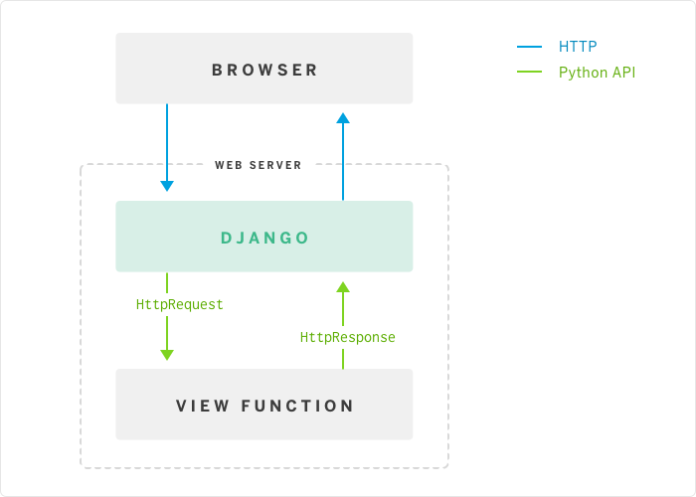
Pickling and deploying a simple model using Flask-
Flask / Django is a Python framework that helps create web servers easily. Can be used for working POC development
The web server call the model object predict() function for the given input, capture the results and render it using a template
Model

Slide 75
Model testing in production -
Models are often tested using Kfold approach where the hyper parameters are evaluated using the gridsearch or randomsearch
Once the models perform well relative to some pre-defined benchmark such as the 95% confidence performance in production ranges from 80% - 90%, they are deployed into production
However, in production too they have to be tested, akin to alpha testing beta testing but the evaluation may happen over time, not immediately as in testing
If a production model already exists, perform A/B testing –
The new model is run in parallel with existing model.
Input data is routed to both the models
The prediction accuracy distributions are compared using hypothesis testing
If this is a new first time model –
Redesign the production processes (maybe temporarily) to feed data to the model
Capture distribution of metrics of interest (metrics used in testing)
Is the 95% confidence level found before deployment being met?

Slide 76
Model testing in production -
To evaluate the model in the production testing, we need to have predefined metrics in place and these metrics may not always be measurable immediately. For e.g. how can the mpg prediction model be evaluated in production?
To predict modeling accuracy, one needs to collect lot of cases /data. Cannot judge based on one single data point.
The models should be evaluated not only on the model metrics but also using business metrics. Did the new model impact topline significantly (statistical testing)
Whether the model is finally going to be deployed in streamline or batch mode, assessing the usefulness of the model will take time
All models drift over time. Their predictive power degrades with time. This may be due to changes in the production environment such as changing importance of the attributes, appearance of new attributes that were not part of the data while the model was built
All models need re-calibration regularly where the frequency is problem specific. Models also have to be scraped / replaced over time

Slide 77
Model deployment and infrastructure -
Deployment includes integrating the model with other systems such as the BI systems for reporting
It may also require integrating with other applications such as back office systems that may be both upstream and down stream
Deployment also need attention towards scaling. The model should scale automatically
The kind of tools and technologies required** will depend on how the model is to be made available. If it is to be available through api as a service, it may need
Industry strength Webservers
Load balancers
SSL configuration
Webserver gateway interface for forking workers
** Ref : https://medium.com/@maheshkkumar/a-guide-to-deploying-machine-deep-learning-model-s-in-production-e497fd4b734a

Slide 78
ThankYou

